Slide 1
Cloud-based Lecture Capturing System

Slide 2
2.
Lecture Movement Capture
IT15021076 - H.M.S.V. Mudalige

Slide 3
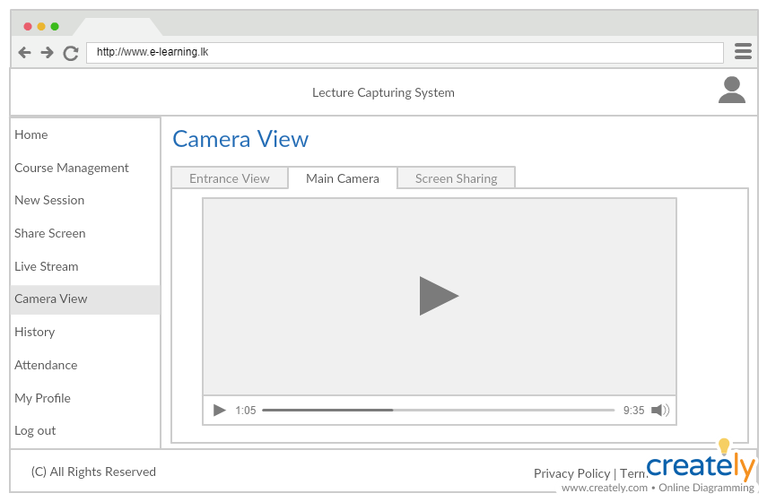
Capturing Lecture Movement
Turn the camera according to lectures movement.
Always ensure lecturer is well oriented in the video by automatically focusing on lecturer on real time. (Using PTZ Feature)
IT15021076- H.M.S.V. Mudalige

Slide 4
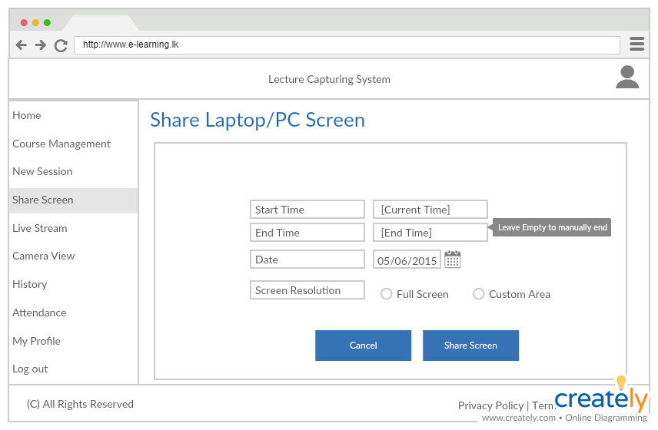
Easy Screen Sharing
With the ability to share the screen either completed or selected custom area right from the web browser and start streaming it along the main video makes the lectures task easier and more efficient.
IT15021076- H.M.S.V. Mudalige

Slide 5
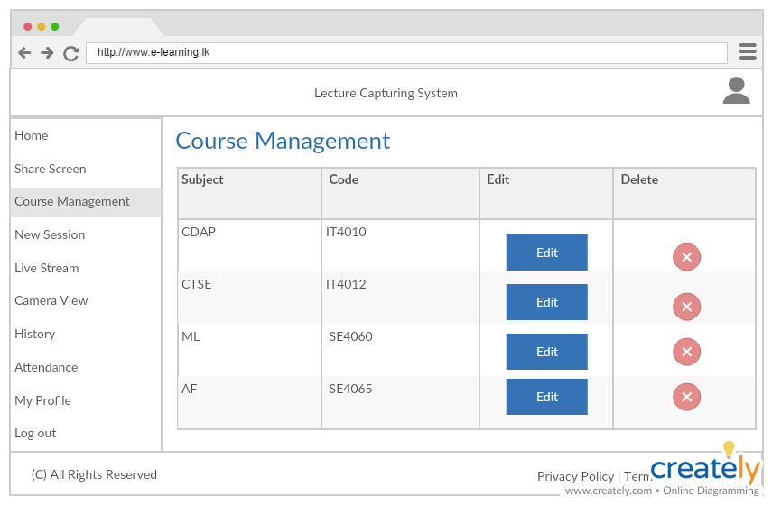
Course Management
Place your screenshot here
Course Management
Manage multiple courses in the Main application to accommodate multiple courses to use LCS simultaneously.
IT15021076- H.M.S.V. Mudalige

Slide 6
Behind the Scenes
Lecture Movement Capture
IP PTZ Camera to capture the lecturer.
Feed is automatically adjusted to accommodate best viewing angle.
Camera is connected via ethernet to perform ptz features and to stream data to the main server.
Easy Screen Sharing
Use WebRTC Screen Sharing chrome extension to add the feature.
Can select whether to share the whole screen or just a cropped part.
IT15021076- H.M.S.V. Mudalige

Slide 7
3.
Screen Capturing
and
Quota Management
IT15010322 - L. C. Tennakoon

Slide 8
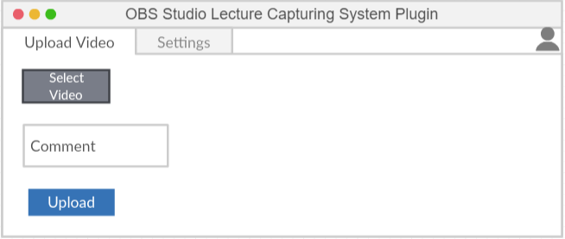
OBS Studio Plugin
Offline recording feature via OBS Studio.
Directly upload to the central server.
IT15010322 - L. C. Tennakoon

Slide 9
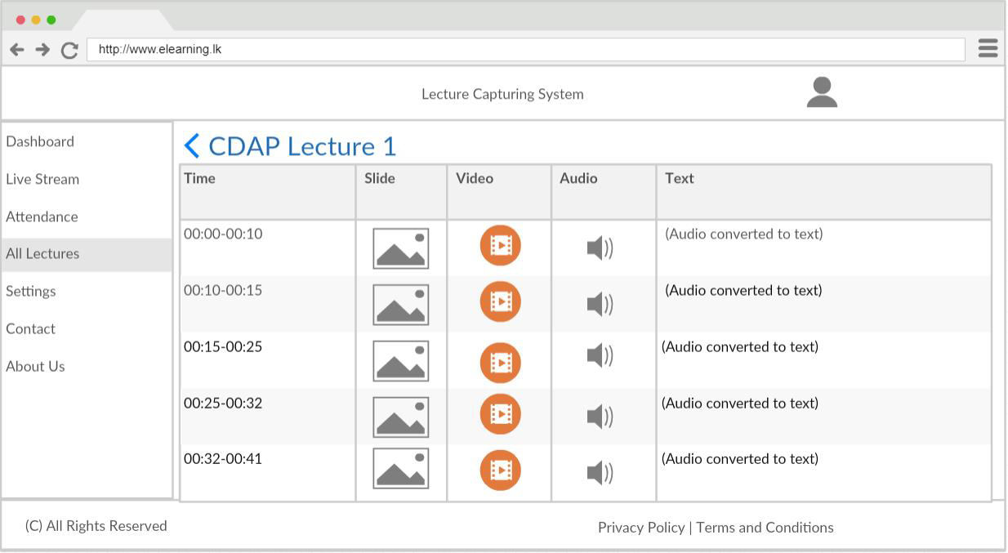
Video Thumbnails Creation
Split video to represent each presentation slide.
Convert audio to text.
IT15010322 - L. C. Tennakoon

Slide 10
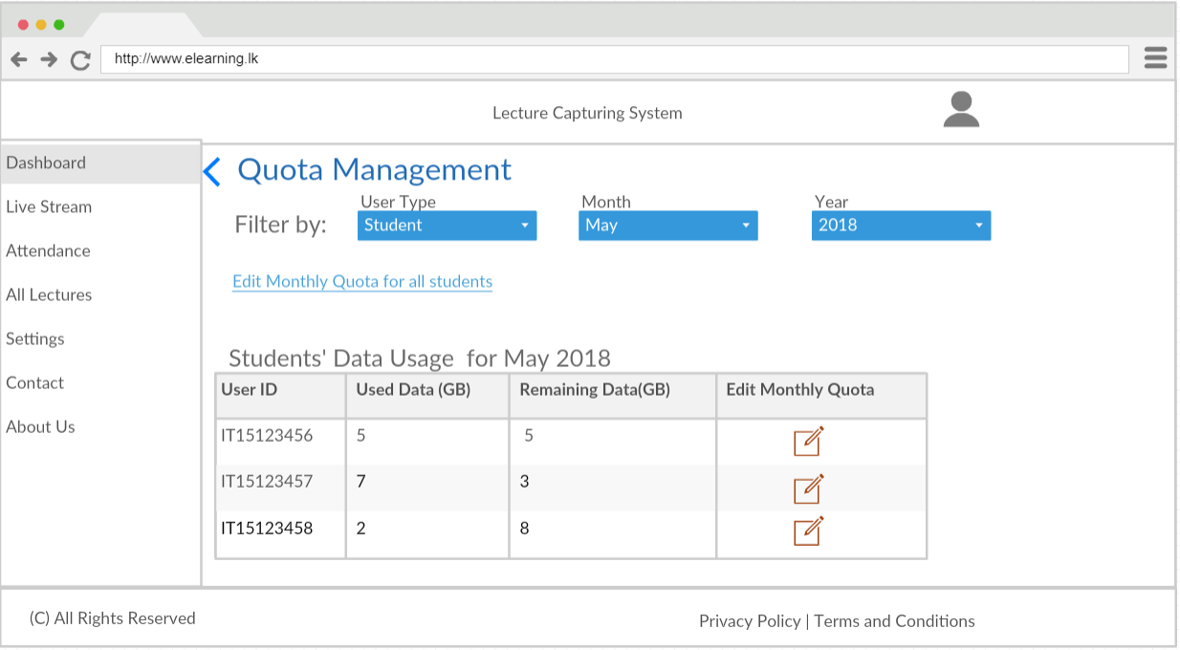
Quota Management
Manage the monthly quota allocation for different users.
IT15010322 - L. C. Tennakoon

Slide 11
4.
Facial Recognition & Bandwidth Management
IT15087898 - A. P. Jayasinghe

Slide 12
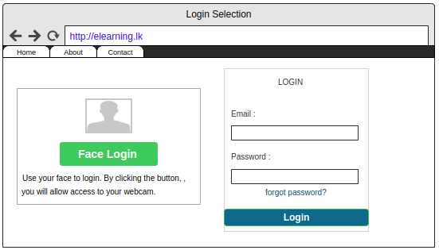
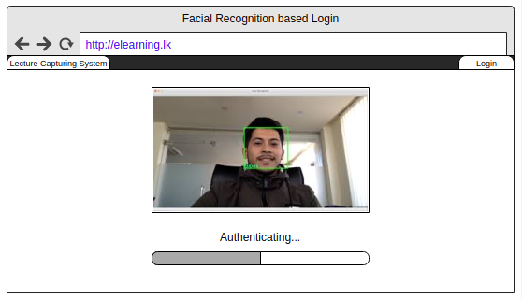
Facial Recognition based login
IT15087898 - A. P. Jayasinghe

Slide 13
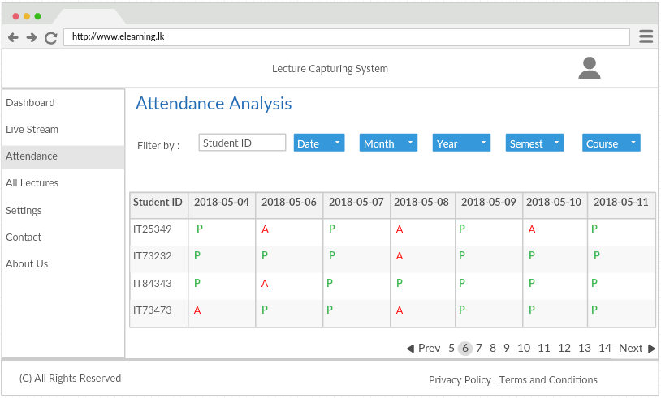
Automated Attendance Marking
IT15087898 - A. P. Jayasinghe

Slide 14
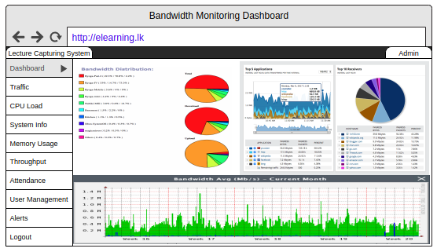
Bandwidth Management
IT15087898 - A. P. Jayasinghe

Slide 15
THANK YOU

